Slide 1
Final Year Project : Studying the effects of vision on balance

Slide 2
The hypothesis:
Affecting visual stimuli when a person sways, such that the sway of the stimuli is different from expected, should result in the person having difficulty to balancing.
Excessively affecting visual stimuli however, will have less or no effect on the person’s ability to balance

Slide 3
The core approach
Create a Virtual Reality Environment
Using different inputs, change the visual stimuli in the environment accordingly

Slide 4
Wiiboard Justification

Slide 5





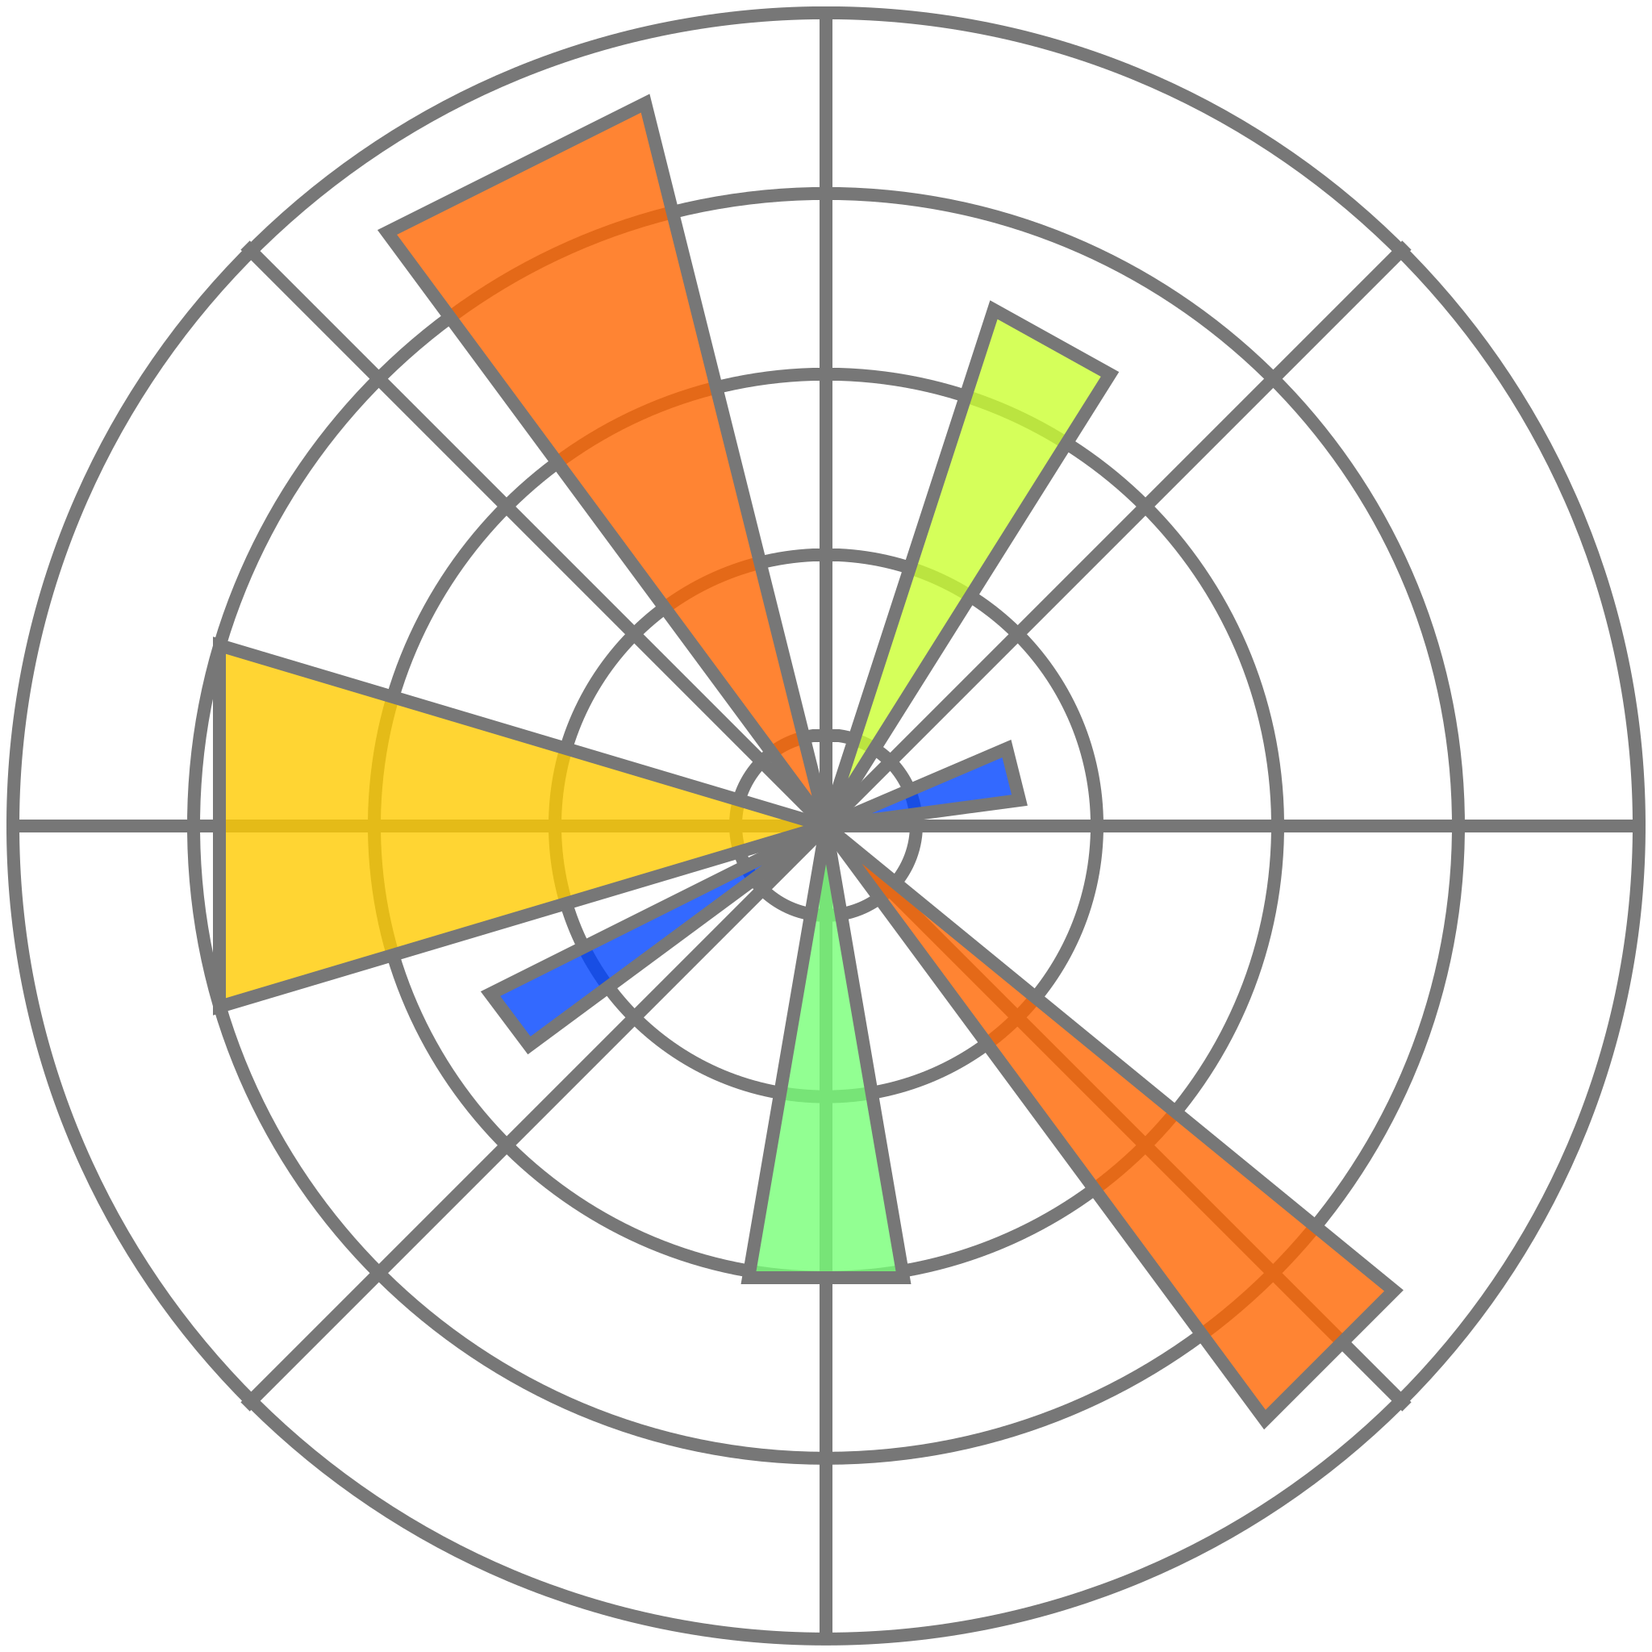
Program structure
Unity project scene
UDP Client with Wiimote Library
Python script
Bluetooth
C# UDP Socket
UDP Server
Wiiboard
Pimax Virtual reality headset
Matplotlib
Unity code

Slide 6
Experiments
How many, what parameters

Slide 7
Experiments Results + analysis

Slide 8
Conclusion

Slide 9
Demo!

